Slide 1

Name of the School: School of Computer Science and Engineering
Course Code: E2UC201C Course Name: OOPS
DICE ROLLER SIMULATOR
Presented By
AKASH KUMAR
23SCSE1011715
SWARAJ KUMAR
23SCSE10110883
. Section : ‘10’
Guided By
Dr Amit Sir

Slide 2
INTRODUCTION
In this Python project, we'll create a digital version of the popular board game Ludo using object-oriented programming principles. The game will involve players taking turns to roll a dice and move their tokens around the board. We'll design classes to represent the game board, players, tokens, and the dice, encapsulating their respective functionalities. By employing OOP concepts such as inheritance, encapsulation, and polymorphism, we'll create a modular and scalable Ludo game simulation in Python."

Slide 3
Name of the School: School of Computer Science and Engineering
Course Code: E2UC201C Course Name: OOPS
Problem Statement
Manual Dice Rolling Hassles: Rolling dice manually in games or educational activities can be tedious, prone to errors, and time-consuming, especially when multiple dice are involved.
Gameplay Disruptions: Manual dice rolling may disrupt the flow of gameplay, leading to delays and distractions, particularly in fast-paced gaming environments.
Accuracy Concerns: Human errors in manual dice rolling can affect the integrity of the game, potentially leading to unfair outcomes or discrepancies in results.
Educational Limitations: In educational settings, manual dice rolling might hinder the efficiency of activities that require random number generation, such as probability simulations or statistical experiments.
Need for Automation: There is a growing need for a reliable and efficient solution to automate the dice rolling process, ensuring accuracy, convenience, and seamless integration into various gaming and educational applications.

Slide 4
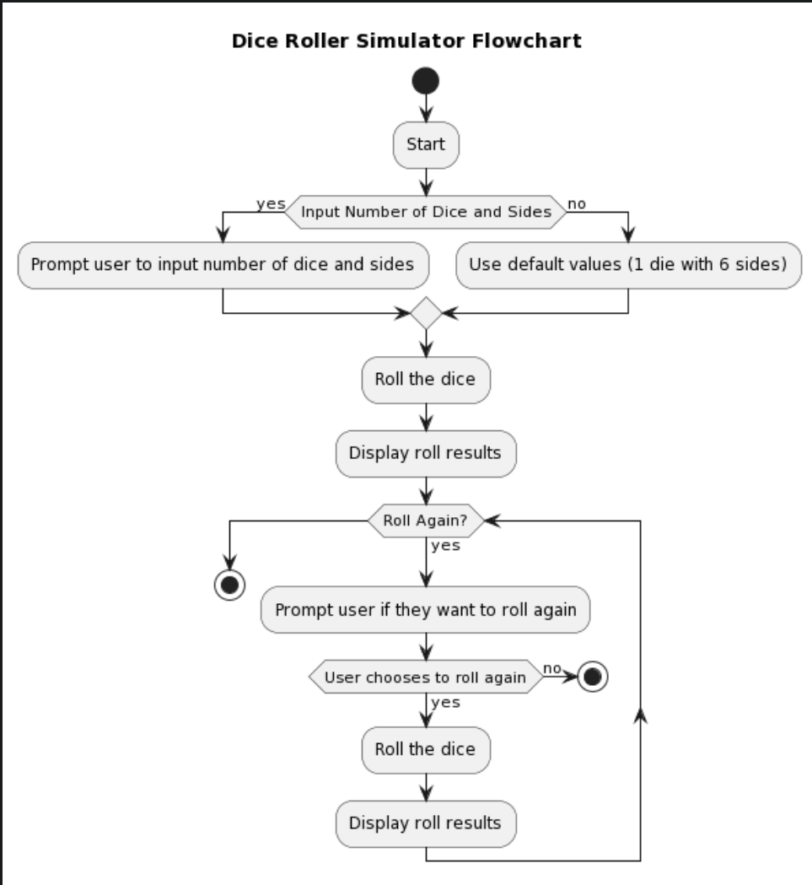
Name of the School: School of Computer Science and Engineering
Course Code: E2UC201C Course Name: OOPS
Flowchart

Slide 5
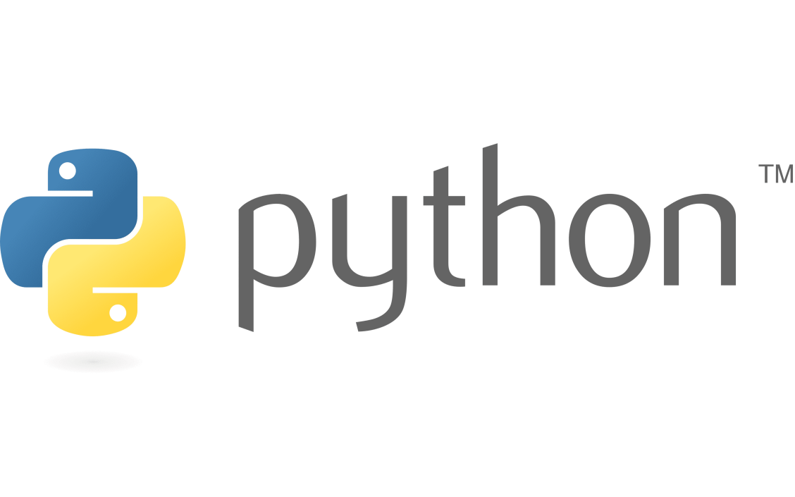
Name of the School: School of Computer Science and Engineering
Course Code: E2UC201C Course Name: OOPS
Technology Used
In the development of the Dice Roller Simulator, we employed several key technologies to ensure efficiency, reliability, and ease of use. Below are the core technologies utilized in this project:
Python Programming Language:
Python was chosen as the primary programming language due to its simplicity, versatility, and extensive libraries.
It allowed for rapid development and easy integration of features required for simulating dice rolls.
Object-Oriented Programming (OOP) Concepts:
Object-oriented programming principles were employed to structure the code effectively.
Classes and objects were utilized to encapsulate related data and functionality, enhancing modularity and reusability.
Random Module:
The random module in Python provided essential functions for generating random numbers.
It enabled the simulation of random dice rolls, ensuring fairness and unpredictability in gameplay.

Slide 6
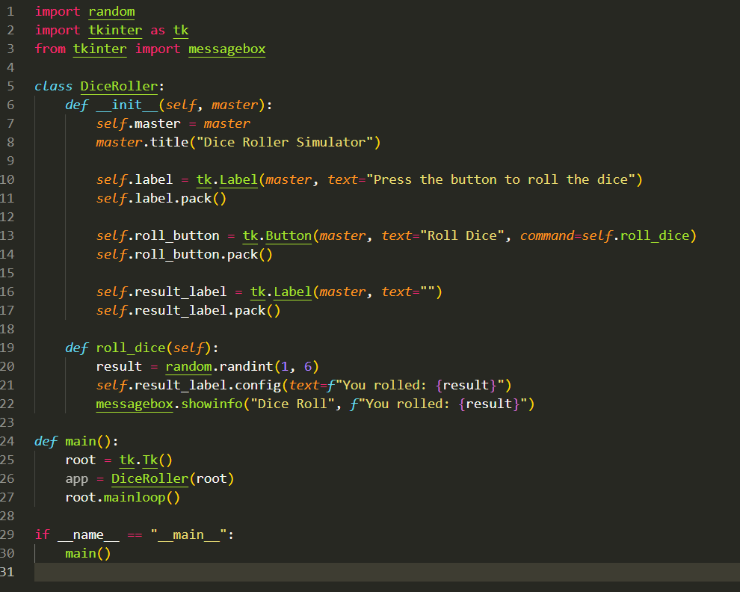
Name of the School: School of Computer Science and Engineering
Course Code: E2UC201C Course Name: OOPS
Source code

Slide 7
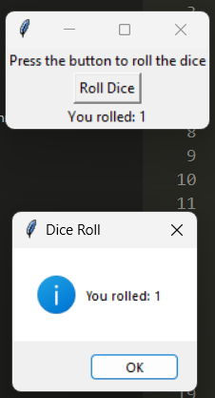
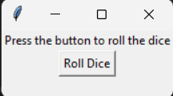
Name of the School: School of Computer Science and Engineering
Course Code: E2UC201C Course Name: OOPS
Result

Slide 8
Name of the School: School of Computer Science and Engineering
Course Code: E2UC201C Course Name: OOPS
Conclusion
Efficiency and Convenience:
The Dice Roller Simulator streamlines the dice rolling process, offering users an efficient and convenient solution for generating random numbers in gaming and educational activities.
Customizability and Adaptability:
With its customizable parameters, including the number of dice and sides, the simulator adapts to various gaming scenarios and educational exercises, catering to diverse user preferences.
User-Friendly Experience:
The intuitive interface of the simulator ensures a user-friendly experience, enabling seamless interaction and easy interpretation of roll results.
Accuracy and Fairness:
Through advanced random number generation techniques, the simulator maintains accuracy and fairness in dice rolls, enhancing the integrity of gameplay outcomes.
Continued Innovation:
Looking ahead, the project aims to continue innovating, exploring opportunities to enhance features, refine the user interface, optimize performance, and engage with the community for ongoing improvements.

